Slide 1
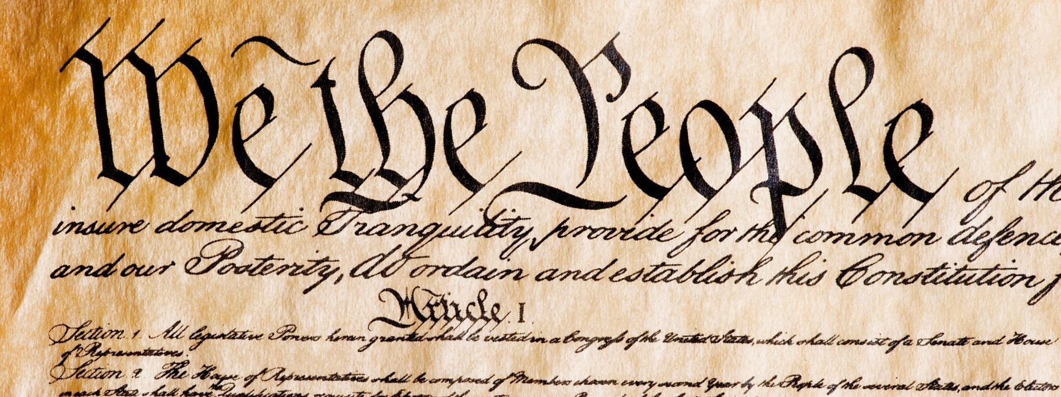
The federalist papers
GV100 class slides: LT week 3
London School of Economics and Political Science

Slide 2
Questions/comments to start the class
Remember, these can just be simple questions or comments about the material.
It is always worth it to ask a question if you are confused or not fully sure about something!

Slide 3
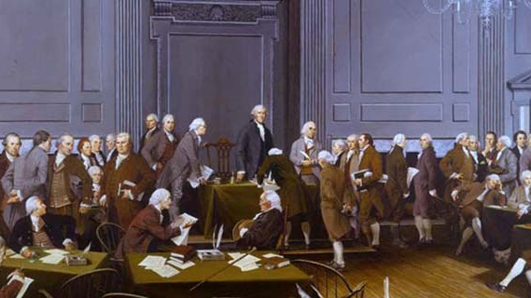
What is the aim of the federalist papers?

Slide 4
Interested in setting out a new constitution for the 13 colonies.
Want to defend the possibility of an extended republican government.
Concerned with the problem of factions and the way in which they undermine popular sovereignty.
Want to set out the system of checks and balances, and the powers of the executive, legislative and judiciary.

Slide 5
What are the federalist papers proposing?

Slide 6
Republicanism and democracy
“The two great points of difference between a Democracy and a Republic are, first, the delegation of the Government, in the latter, to a small number of citizens elected by the rest: secondly, the greater number of citizens, and greater sphere of country, over which the latter may be extended” (Federalist 10).
What does this passage tell us about the difference between republicanism and democracy? Why is this important?

Slide 7
How should we be represented?
Mandate theory: representatives should put forward the feelings and passions of the people they represent.
Independence theory: representatives should defend the interests of the people they represent, as they judge those interests.
Activity: speak together in groups. Which form of representation do you think is more desirable?

Slide 8
The problem of factions
“By a faction I understand a number of citizens, whether amounting to a majority or minority of the whole, who are united and actuated by some common impulse of passion, or of interest, adverse to the rights of other citizens, or to the permanent and aggregate interests of the community” (Federalist 10).
Madison thinks that there are two ways of dealing with factions: (i) removing their cause, and (ii) controlling their effects. What are his arguments against (i) and how does he suggest we go about (ii)? How does Madison differ from Rousseau on this issue?

Slide 9
Division of powers
“In order to lay due foundation for that separate and distinct exercise of the different powers of government, which to a certain extent, is admitted on all hands to be essential to the preservation of liberty, it is evident that each department should have a will of its own; and consequently should be so constituted, that the members of each should have as little agency as possible in the appointment of the members of the others” (Federalist 51).
Executive: Needs to be unified in a single person, in order to allow for quick action and there is a clear line of responsibility. (Federalist 70)
Legislative: The remedy for the power of the legislative is ”to divide [it] into different branches; and to render them by different modes of election, and different principles of action, as little connected with each other, as the nature of their common functions […] will admit” (Federalist 51)
Judiciary: “A constitution is in fact, and must be, regarded by the judges as a fundamental law. It therefore belongs to them to ascertain its meaning as well as the meaning of any particular act proceeding from the legislative body” (Federalist 78).

Slide 10
Further questions
How should we evaluate the success or failure of The Federalist? Was it successful?
Does the US Government avoid the problems that the founders wanted it to avoid?
Was Hamilton right to oppose the Bill of Rights?
What status should The Federalist Papers have now?
Any other questions you have.

Slide 11
Extra resources
Constitution Center podcast on ratification and the Federalist papers
‘Constitutional’ podcast episode on the constitutional convention
Vox video on the electoral college
‘Non-stop’ song from Hamilton musical (partly about the Federalist papers)
In Our Time episode on George Washington

