Slide 1
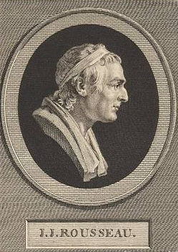
Rousseau’s Social Contract
GV100 class slides: MT week 11
London School of Economics and Political Science

Slide 2
Questions/comments to start the class
Remember, these can just be simple questions or comments about the material.
It is always worth it to ask a question if you are confused or not fully sure about something!

Slide 3
The second discourse
In the ‘Second Discourse’, Rousseau diagnoses a problem that he sees in contemporary society. This is the problem of problematic social dependence and a corrupt social contract. He offers two solutions to this problem in later work:
- Educational Reform in Emile
- Social Reform in The Social Contract
Important terms: amour propre, amour de soi, pity

Slide 4
Rousseau on Education
“It suffices that, enclosed in a social whirlpool, he not let himself get carried away by either the passions or the opinions of men". (Emile, IV)
Rousseau thinks that education can help boys to live less through the eyes of others, thus dulling the impact of amour propre. Girls, he believes, are less upset by a lack of independence, since their comparative natural weakness requires them to find protection from another. The education they receive helps them to secure and that protection.

Slide 5
The social contract
What is Rousseau’s aim in writing The Social Contract?
“ ‘To find a form of association that will defend and protect the person and the goods of each associate with the full common force, and by means of which each, uniting with all, nevertheless obey only himself and remain as free as before' This is the fundamental problem to which the social contract provides the solution." (The Social Contract, I.vi)
How is the social contract meant to solve this problem? How does Rousseau’s social contract differ from that of Hobbes and Locke?

Slide 6
What is the general will?
Particular will:
Will of all:
General will:
This is the particular interests of each person, determined by their individual interests.
This is the aggregate of all the particular wills taken together. This is still a private will.
This is the common interest, understood in terms of the interest that each person has as one constituent member of the sovereign. The General Will is a public will.

Slide 7
The general will: two readings
The democratic reading:
“I say, then, that sovereignty, being nothing but the exercise of the general will, can never be alienated, and that the sovereign power, which is in fact a collective being, can be represented only by itself; power indeed can be transmitted, but not will." (The Social Contract, II.i)
The trascendant reading:
It follows from what precedes that the general will is always right and always tends to the public good; but it does not follow that the deliberations of the people always have the same rectitude. Men always desire their own good, but do not always discern it; the people are never corrupted, though often deceived, and it is only then that they seem to will what is evil." (Social Contract, II.iii)

Slide 8
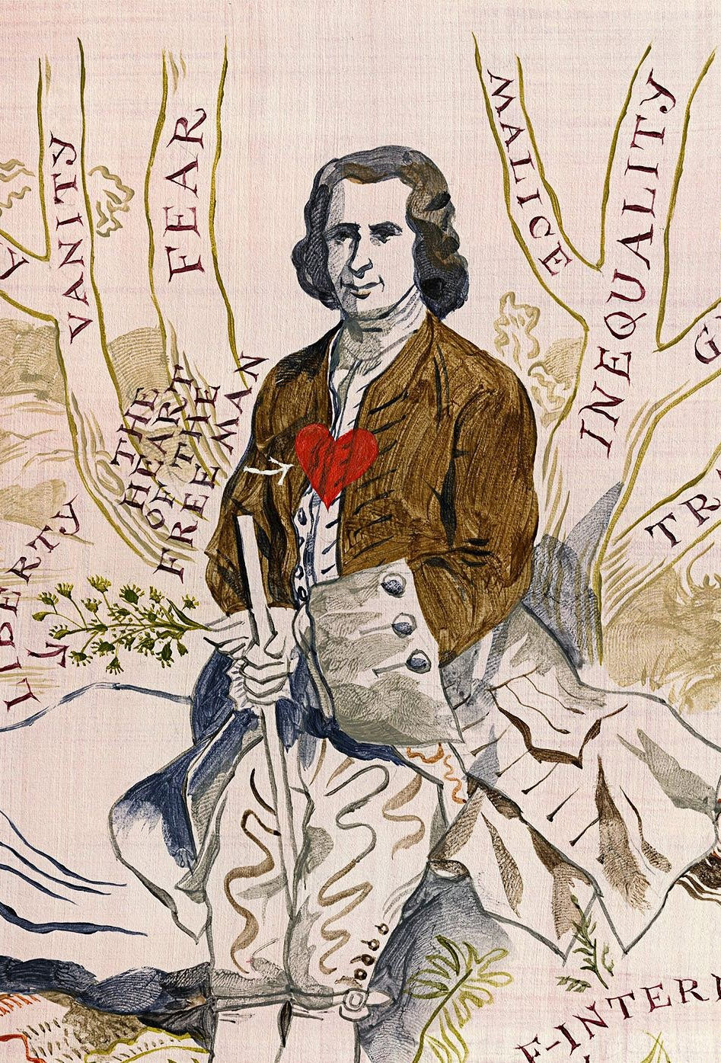
Assessing Rousseau
Remember the fundamental problem that the social contract is meant to solve. Does the idea of the General Will and all that comes with it solve that problem?
“ ‘To find a form of association that will defend and protect the person and the goods of each associate with the full common force, and by means of which each, uniting with all, nevertheless obey only himself and remain as free as before' This is the fundamental problem to which the social contract provides the solution." (The Social Contract, I.vi)

Slide 9
Justifying state coercion
Think about the justification for the use of state coercion that we’ve seen this term. Are any of them successful at explaining why the state is entitled to tell us what to do? Why or why not?

Slide 10
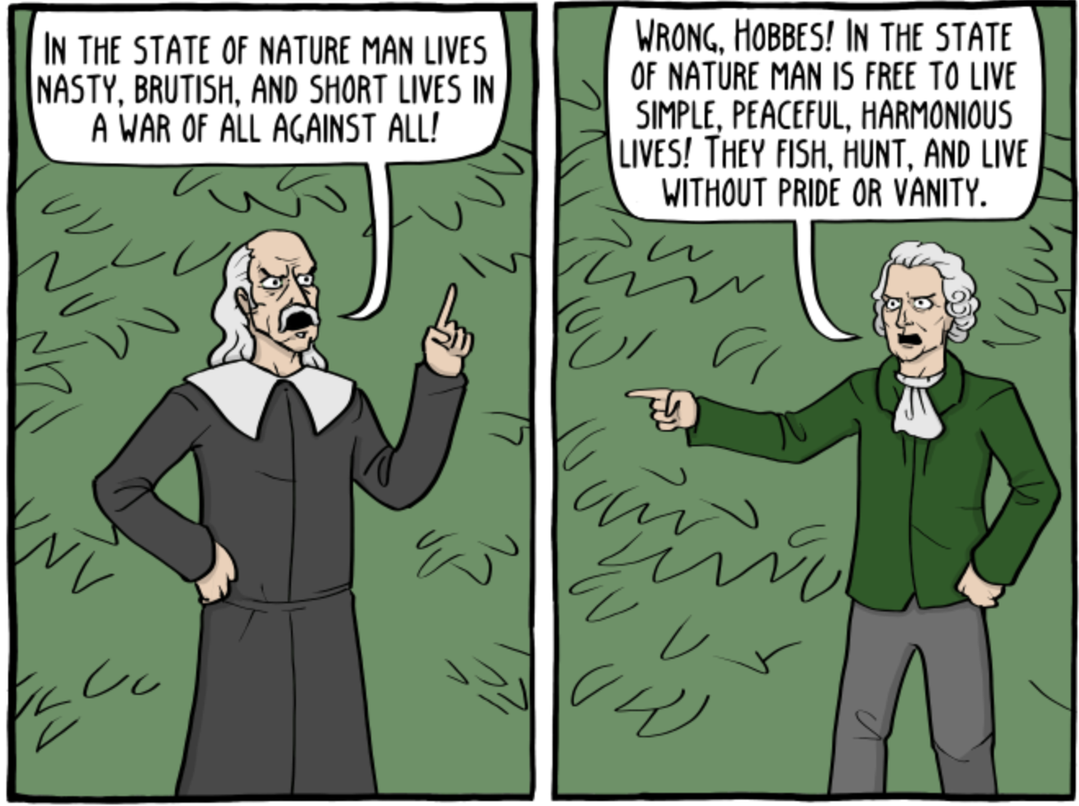
Extra resources
In Our Time episode on the Social Contract
Philosophy bites episode on Rousseau’s Moral Psychology
Philosophy bites episode on Rousseau on Modern Society
Existential Comics comics featuring Rousseau
New Yorker article on Rousseau and Trump
Source: Existential comics

