Slide 1
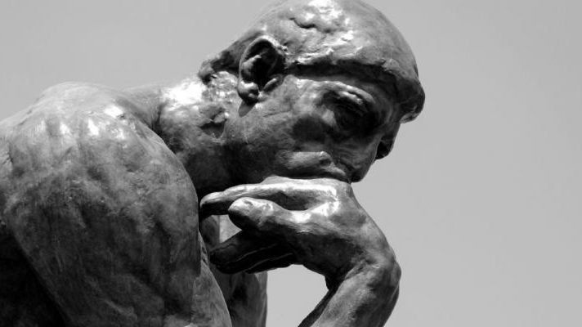
Introduction to GV100
GV100 class slides: MT week 2
London School of Economics and Political Science

Slide 2
Overview of today’s class
Getting started
Doing political theory
Essay writing
Plato on justice (if we have time)

Slide 3
Introductions
1. Getting started
What is your name?
What is your programme?
Would you take GV100 if you didn’t have to?
(No judgement!)

Slide 4
COVID-19
1. Getting started
You are required to wear a mask.
If you are exempt from wearing a mask, please let me know and show me your LSE exemption.
Failure by members of the class to follow the LSE’s covid guidelines will result in the end of the class (this is a last resort!).
If you don’t feel comfortable with some of the behaviour in the class, please let me know either in class or privately.
If you can’t make class, ask someone for notes or get in touch with me. It would also be worth having a class WhatsApp group.

Slide 5
Office hours
1. Getting started
These will take place on Thursdays from 1.30-3.30 in CBG 3.11 (starting in week 3).
Please book meeting times via the Student Hub. Bookings will be available one week in advance, and slots are 20 minutes long.
I am also flexible about meeting outside of normal office hours if you can’t make the normal times. Just send me an email at l.j.davies@lse.ac.uk. Meetings outside of normal office hours will take place on Zoom.
Office hours get busy before essays are due. Plan ahead!

Slide 6
Formative assessment
1. Getting started
There will be one formative assessment (i.e., not for marks) due on 9 November.
Topics are already on Moodle.
We will be strictly enforcing late penalties and the word limit.
All the topics for the year have been released, and all the lectures on the formative essay topics are already on Moodle. It is worth choosing an essay topic now!

Slide 7
Summative assessment
1. Getting started
There are three summative assessments (i.e., for marks). They are due on 4 January, 15 March, and 3 May.
Each summative counts for 33% of your grade.
If your formative paper does better than one of your summative papers, we will count the formative paper instead.
So, your GV100 grade is calculated by taking the average of the best three of the four papers you will write.

Slide 8
Gv100 classes
1. Getting started
These classes:
Give you a chance to ask questions about the material
Help to prepare you for the assignments
Allow you to practice your critical engagement skills by discussing the course material with your classmates and with me.
Simple rules for class discussions: be respectful of each others’ views, tell us why you believe what you believe (don’t just assert your position), join in!
Every class will start with everyone asking a question or making a comment about the material for the week. This is a very low stakes exercise!

Slide 9
Doing political theory
2. Doing political theory
Political theory is concerned with normative arguments related to different elements of social/legal/political institutions and, more generally, to interpersonal interaction.
Some of the questions that we will address are:
What is justice?
Where do our ideas of justice come from and what does that tell us about them?
Should there be states?
Who gets to make the rules? Who gets to enforce them?
What is the relation between politics and the economy?
How should we deal with the sexist and racist history of philosophy?

Slide 10
Normative vs. descriptive
2. Doing political theory
Normative:
About how things should be
Example: there should be no death penalty in the US because it is immoral.
Descriptive:
About how things really are.
Example: some states in the US impose the death penalty.
In GV100 we are primarily interested in normative theorizing.

Slide 11
Two central tasks of gv100
2. Doing political theory
1. Understand the texts and arguments
You need to spend time with the texts and make an effort to understand them, to extract arguments from them, and to reconstruct those arguments in your papers.
We will do this in class together as well.
2. Critically engage with those texts and arguments
You also need to engage critically with the arguments you find.
Use the texts to answer perennial questions in philosophy. They are a launching pad to a bigger debate in philosophy!
Critical engagement is central to doing well in this course!

Slide 12
Argue your case!
3. Essay writing
We will speak about this at greater length before the first Aristotle class.
In your essays you need to take a side and argue for a specific point.
Some characteristics of good essays are that they:
Have a central claim -- a “thesis statement”.
Only describe the relevant sections of the text. The essays are not book reports.
Engage critically with the author or text.
Address objections to the view they defend.
Include secondary literature.
There is an excellent guide to philosophy paper writing here.

Slide 13
Providing reasons
3. Essay writing
Don’t just make assertions. Explain why the reader should believe what you believe. For example:
“Plato says that Q. I find that claim plausible for the following reasons…”
“My view is that P. I believe that because…”
Feel free to copy these sentence structures in your papers.
What counts as a reason?
A quote from the text.
An argument from secondary literature.
Your own thoughts! Remember that we want to know what you think about the topics, not just what others have said.

Slide 14
Argumentative essays not book reports
3. Essay writing
Book reports:
Don’t present and defend an argument, they merely summarise the book.
Summarise all of the book instead of being focused and specific.
Do not engage critically with the text, author or idea.
Don’t write book reports.

Slide 15
Essay writing: key takeaways
Read the question carefully! Really!
Take lots of time to read the text.
Use secondary literature to help you understand the material.
Be generous to the author you are discussing.
Write as clearly and concisely as you can. Use a dictionary and not a thesaurus.
Define all your key terms! Don’t assume that your reader knows what you are talking about.
Write for an intelligent non-specialist.
Don’t steal other people’s ideas!
Ask me questions about your paper. Attend office hours.

Slide 16
Plato

Slide 17
The ring of gyges, or why be just?
Activity: Speak about the Ring of Gyges in small groups. Is there any reason to be just when we know we could get away with not being just?
Discuss both what you think and what Plato thinks.

