Slide 1
Kant on Cosmopolitanism and the concept of race
GV100 class slides: LT week 2
London School of Economics and Political Science

Slide 2
Questions/comments to start the class
Remember, these can just be simple questions or comments about the material.
It is always worth it to ask a question if you are confused or not fully sure about something!

Slide 3
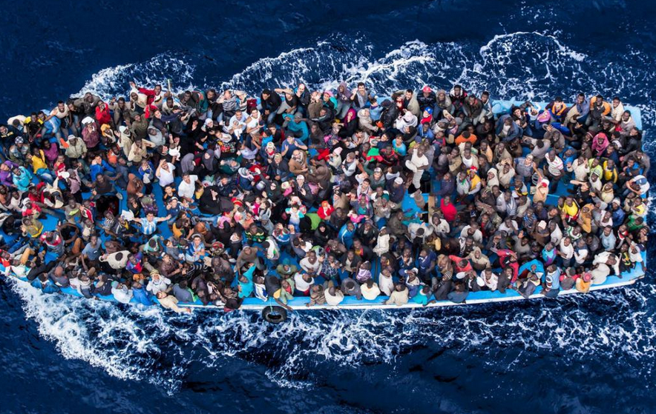
The definitive articles
“The civil constitution in every state shall be republican” Domestic Right
“The right of nations shall be based on a federalism of free states.” Right of nations
“Cosmopolitan right shall be limited to conditions of universal hospitality” Cosmopolitan Right

Slide 4
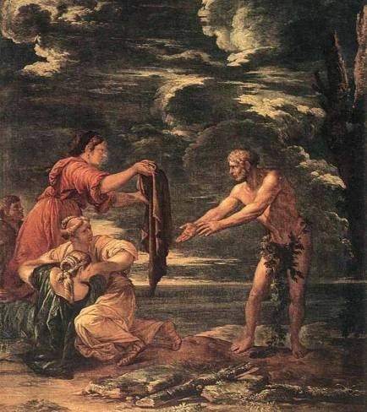
“Cosmopolitan right shall be limited to conditions of universal hospitality”
What does the cosmopolitan Right require? What was Kant trying to achieve with this right?
Are state’s complying with its requirements?
Is it demanding enough?

Slide 5
Kant on Colonialism
“The principles underlying the supposed lawfulness of appropriating newly discovered and purportedly barbaric or irreligious lands, as goods belonging to no one, without the consent of the inhabitants and even subjugating them as well, are absolutely contrary to cosmopolitan right." (Drafts for Perpetual Peace, 23:174)

Slide 6
Two concepts of Race
Racialist race is the familiar and pernicious concept of races as groups of human beings that possess distinct biological essences, resulting in intellectual and characterological differences that mark some race(s) as superior to others. There is nothing in the world that the racialist conception of race refers to. There are no racialist races.
Minimalist race is the (also familiar but non-pernicious) concept of races as groups of human beings distinguishable by visible physical traits that signal differences in geographical ancestry.
Michael Hardimon, Rethinking race: the case for deflationary realism, Harvard University Press: 2017.

Slide 7
Kant’s public concept of race
“The concept of race is therefore: the classificatory difference of the animals of one and the same phylum in so far as this difference is unfailingly hereditary.” (Determination of the concept of a human race 1785, 8:100)
“Thus the germs which were originally placed in the phylum of the human species for the generation of the races must have developed already in most ancient times according to the needs of the climate, if the residence there lasted a long time; and after one of these predispositions was developed in a people, it extinguished all the others entirely.” (Determination of the concept of a human race 1785, 8:105)
These passages seem to speak in favour of a minimalist race concept. But…

Slide 8
Kant’s private concept of race
“But a continuation of the treatise on human races seems to me to deserve preference [...]. In addition, the above-mentioned principles of a moral characterisation of the various races of the human species will serve to satisfy the tastes of those who do not particularly notice the physical.” (Kant’s Correspondence 10:256).
... in his private correspondence Kant attaches both physical and moral characteristics to different races and this speaks in favour of attributing a racialist race concept to him (even if not to his official definition of race in his published works).

Slide 9
Was kant racist? Scattered comments
“... In short, this fellow was black from head to toe --- clear proof of the fact that what he said was stupid.” (On Feelings of the Beautiful and the Sublime)
“... this race, which is too weak for hard labour and too indifferent for industrious work, and which is incapable of any culture even though there are enough examples and encouragement in the vicinity [namely, the European colonial settlers], stands far below even the Negro, who occupies the lowest of all other levels which we have mentioned as racial differences." (On the use of teleological principles in philosophy)
To read: the debate between Pauline Kleingeld and Robert Bernasconi on Kant’s changing
attitude to race. See the reading list or ask me about it if you’re interested!

Slide 10
What kant a racist? Broader philosophy
“Far from being in contradiction to modernist universal and egalitarianism, then, racism is simply part of it---since the egalitarian theory's terms were never meant to be extended generally outside the European population. What seem to be racist inconsistencies and anomalies in the writings of classical philosophers of the modern period would, if I am right, now turn out to be simple and straightforward implications of racially restricted personhood" (Mills, “Kant's Untermenschen" p.171).
Questions: Do Kant's writings on race provide evidence for the view that he restricted personhood to (white) Europeans? What does your answer tell us about the status of his moral philosophy?

Slide 11
Was Kant racist? Progress and cosmopolitanism
“The ‘others’ (non-Europeans) will receive the Law of Reason from Europe or, in Kant's words, ‘our continent ... will probably give law, eventually, to all others.’ Those who cannot reason ... cannot be expected to effect ‘man's release from his self-incurred tutelage,’ since they lack the faculty for this human possibility. Thus, Europe has to give the ‘law’ to ‘all the others’.... What we need to examine next is how Kant legitimates this de facto (i.e., historical and thus contingent) globalisation of Europe and makes it the de jure actualisation of the Idea [of progress]." (Serequeberhan, “The Critique of Eurocentrism and the Practice of African Philosophy” p. 149).
Questions: What evidence can we give for Kant's Eurocentrism? What does that tell us about the status of his cosmopolitanism?

Slide 12
Further questions
What should we think about the status of Kant's racist remarks? Can we continue to benefit from his moral philosophy?
In general, how should we address the history of racism in political philosophy?
Should we seek to eliminate the concept of race?

Slide 13
extra resources
Arthur Ripstein’s Tanner lectures on Kant’s philosophy of war
Review of Hardimon’s Rethinking Race
The Philosophy of Race, discussion at LSE from 2018
Ta-Nehisi Coates essay on race as a social construct

