Slide 1
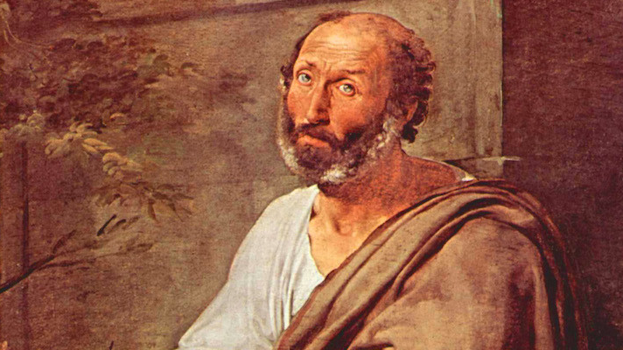
Aristotle’s Politics
GV100 class slides: MT week 4
London School of Economics and Political Science

Slide 2
Questions/comments to start the class
Remember, these can just be simple questions or comments about the material.
It is always worth it to ask a question if you are confused or not fully sure about something!

Slide 3
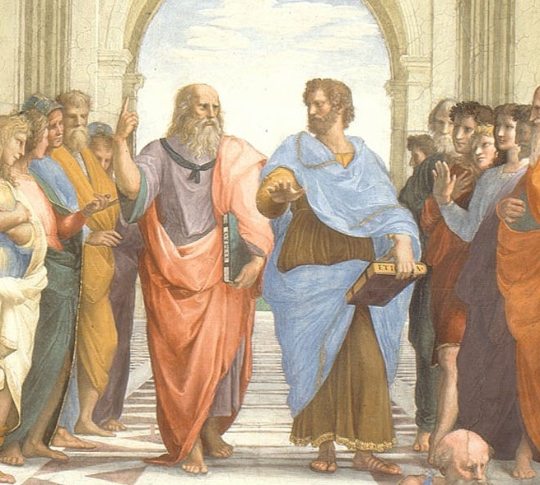
Looking up or looking out?
Activity: Speak with someone next to you. What is the difference between Aristotle's approach to political philosophy and Plato's approach? What are the merits and drawbacks of each?

Slide 4
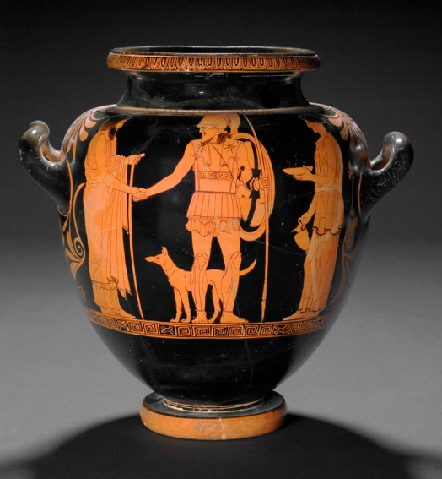
Three kinds of association
Household
Master/slave
Husband/wife
Parent/child
Village
Polis

Slide 5
Humans as political animals
“It is evident from these considerations, then, that a city-state is among the things that exist by nature, that a human being is by nature a political animal, and that anyone who is without a city-state, not by luck but by nature, is either a poor specimen or else superhuman.” (Politics Book I.ii)

Slide 6
Humans as political animals
The city is natural because it comes out of other natural associations and completes the goal of those associations, i.e., self-sufficiency (1252b3-1253a1).
The city is natural because nature has given us speech, which allows us to communicate and live together, and nature does nothing in vain (1253a1-18).
The city is natural because it is necessary for our natural end of living well (1253a29-39).

Slide 7
The status of women and slaves
What is Aristotle’s argument for the rule of men over women?
What is Aristotle’s argument for the rule of masters over slaves? What is the difference between ‘natural’ and ‘conventional’ slaves?
Is Aristotle mistaking social hierarchy for natural hierarchy?
If legitimate slaves are slaves by nature, then how could it be appropriate to free them?

Slide 8
Plato and Aristotle on women
Activity:
Discuss the approaches that Plato and Aristotle take to the place of women in the polis. How do they differ? What are the merits of each? Is there anything to Aristotle’s claim that there are essential differences between the virtues/capacities of men and women?

Slide 9
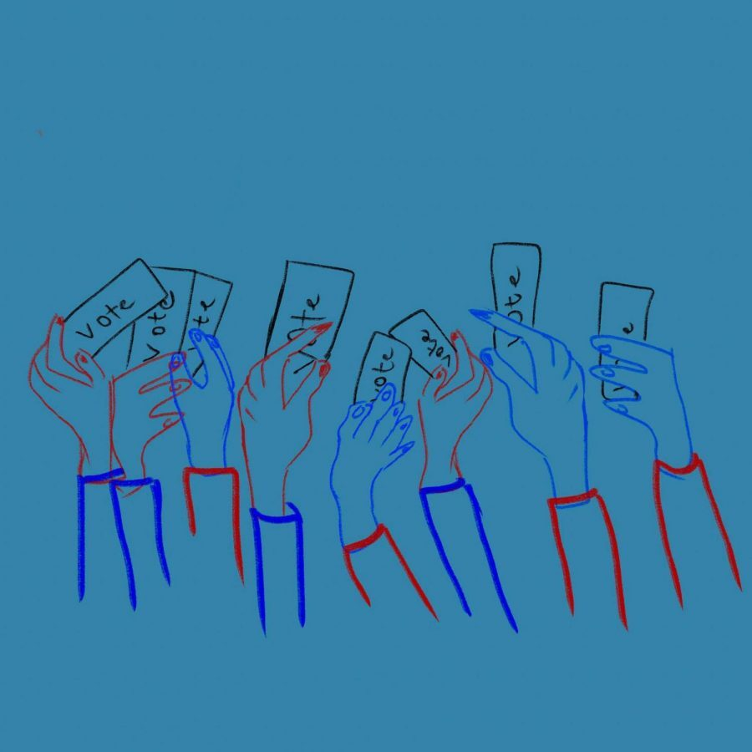
Who should participate politically?
Aristotle raises an important question: Who should have rights of political participation (the right to vote, to hold political office, to serve as a member of a jury)?
Activity: Speak in small groups. Forget Aristotle. Discuss the question above.

Slide 10
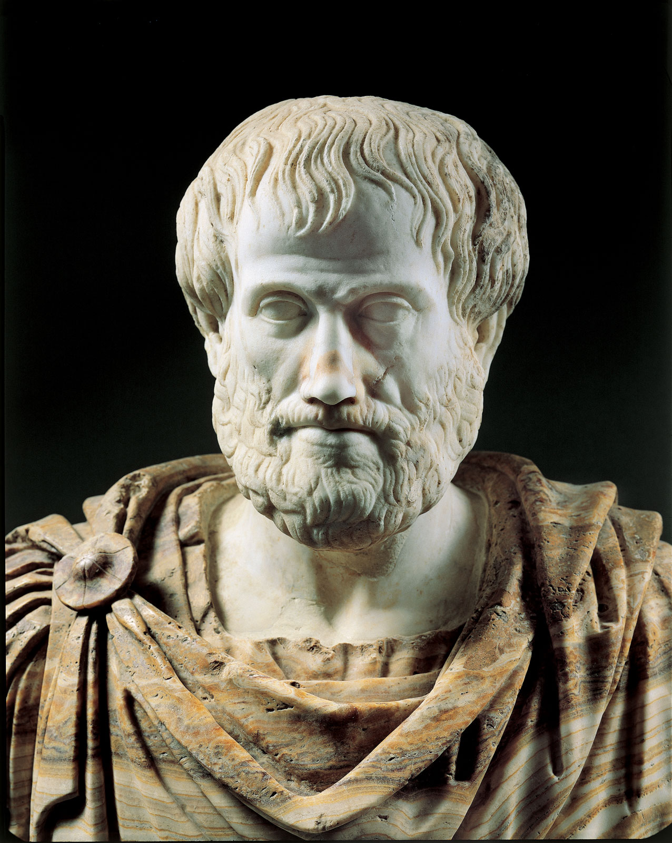
Extra Resources
Philosophy bites podcast on Aristotle’s Ethics
New York Times opinion piece by philosopher Agnes Callard: “Should we cancel Aristotle?” (answer: ‘no’)
In Our Time podcast on Aristotle’s politics
In Our Time podcast on Aristotle’s biology – with helpful comparisons between Aristotle and Plato and some discussion of women and slavery
Forum for Philosophy podcast on Aristotle’s contemporary relevance
Existential Comics on Aristotle’s golden mean

